Slide 1
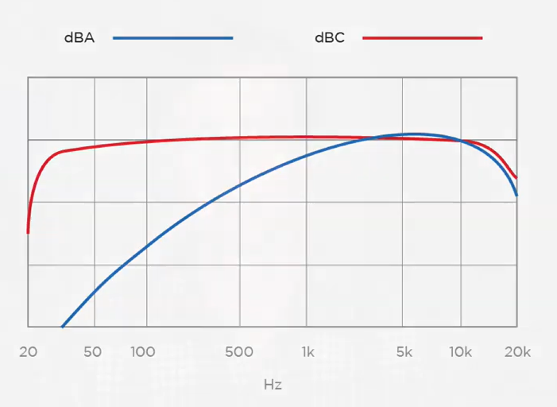

Slide 2
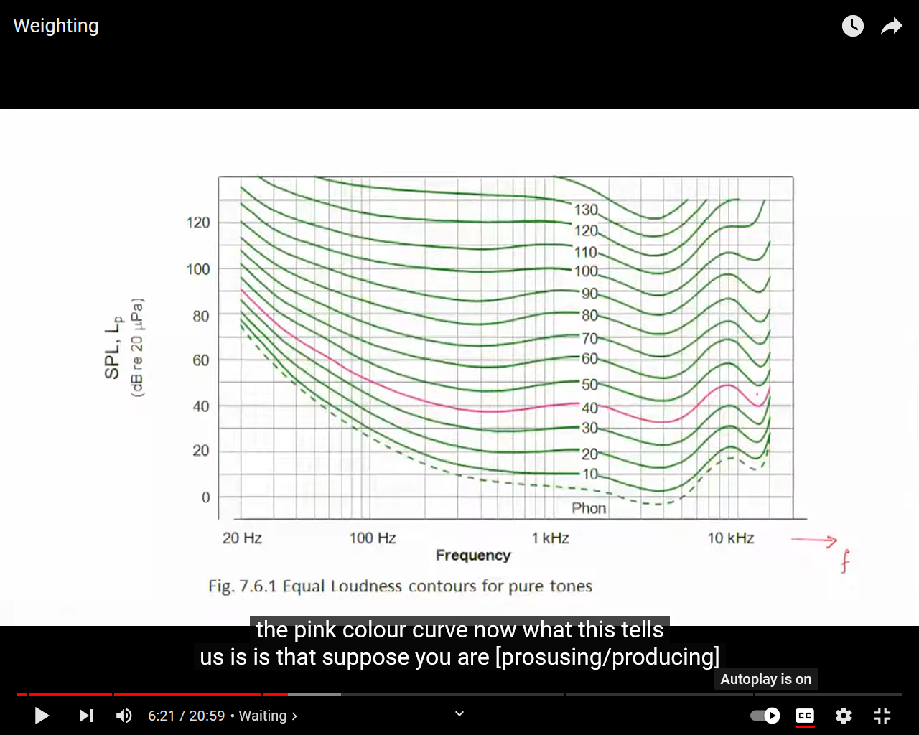

Slide 3
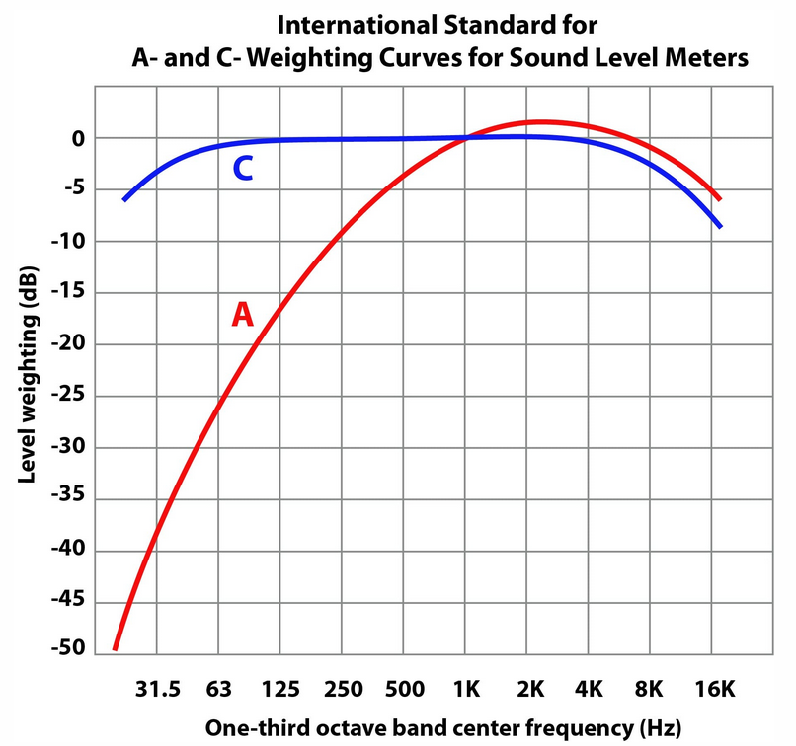
Notes:
https://acoustical-consultants.com/built-environment/noise-investigations/frequency-weighting-sound-level-measurements-a-weighting-dba-vs-c-weighting-dbc/

Slide 4
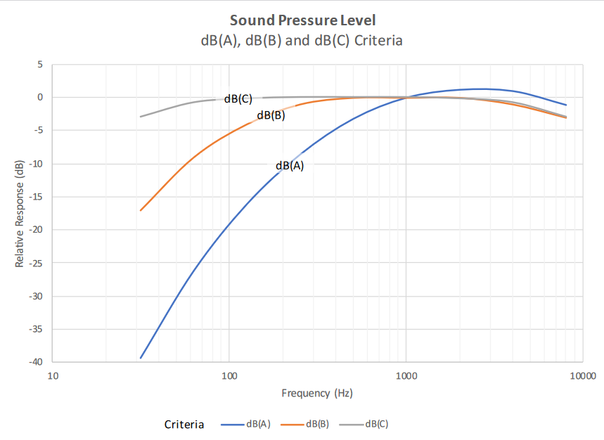

Slide 5
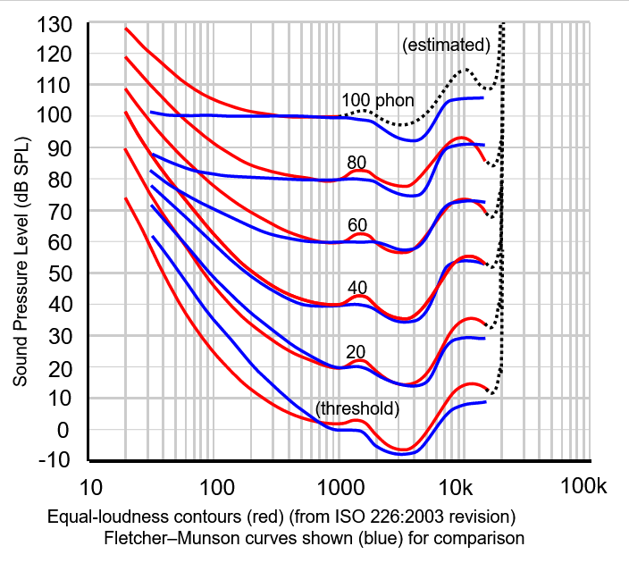
Notes:
https://en.wikipedia.org/wiki/Equal-loudness_contour#/media/File:Lindos4.svg

Slide 6
